Slide 1
TIS Solutions Appraisal Systems

Slide 2
DESCRIPTION:
TIS Solutions has great work with their employees, with this in TIS Solutions they have increasing number of employees.
The motivational and performance level of their employees high. So, they want to implement this Appraisal System.
In the EMPLOYEE APPRAISAL APP all employees can know their performance with employee appraisal app.
This performance can be given in yearly, half-yearly, or quarterly to their employees.
This will help the employees to grow up and enhance skills with appraisal feedback and compliments for accomplishments.
By knowing all their performances employees will know all their accomplishments and they can perform better next time.

Slide 3
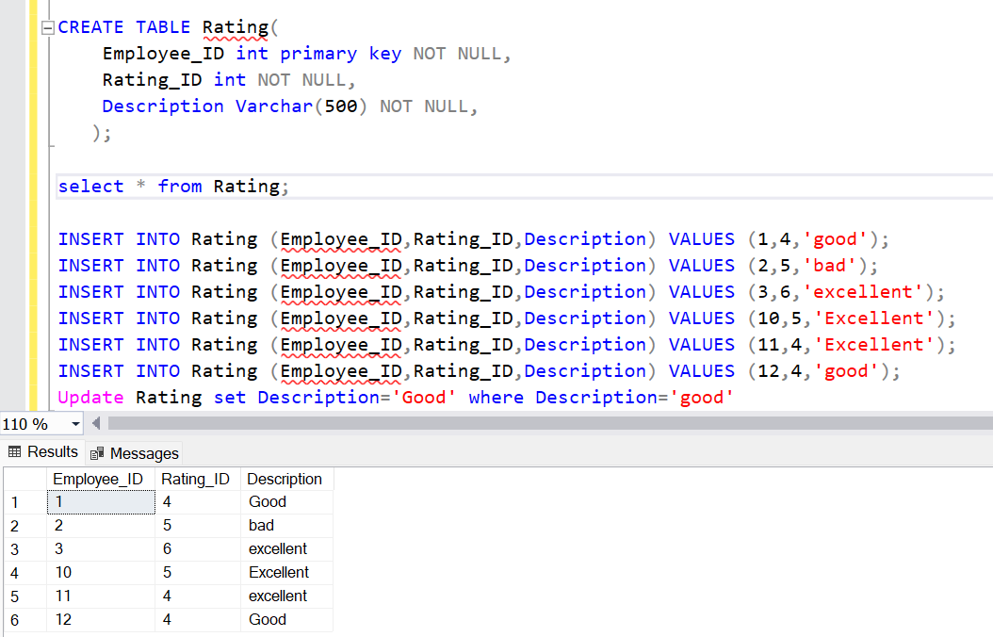
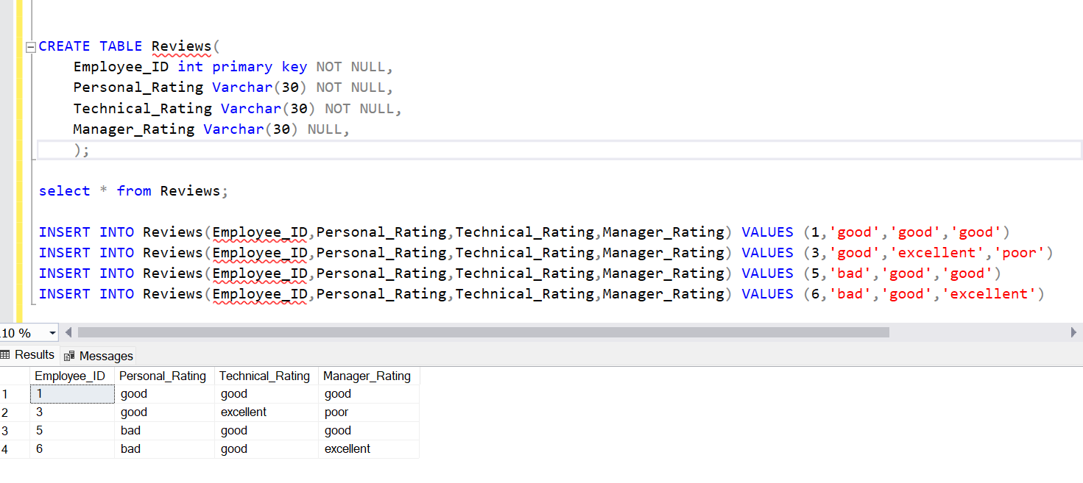
Creating AND Inserting DATA into TABLES

Slide 4
THANK YOU

